Slide 1
Project Seminar, 2024
Land Cover Classification based on Multiscale Time Series of Satellite and Aerial Images
Supervisors:
M.Sc. Hubert Kanyamahanga,
Dr.-Ing. Mareike Dorozynski
Students:
Mahsa Ghandali
Sunanda Menon
Shiva Timilsina
Mohammad Mansouri
Suman Khanal

Slide 2
Overview
Introduction
Methodology
- Baseline architecture
- Self-Supervised Learning (SSL)
Experiments
- Dataset and experimental setup
Results
Conclusion

Slide 3
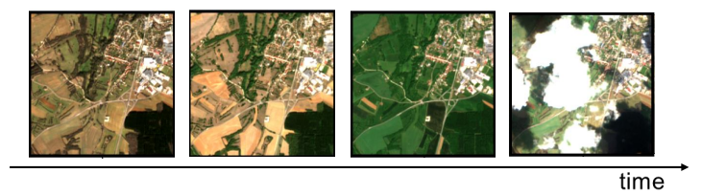
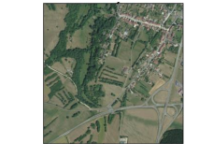
Introduction
Motivation
- To achieve high quality Land Cover (LC) predictions.
- Advantage of combining temporal and spatial information.
- Land Cover Classification for Hameln region.
Satellite Image Time Series (SITS)
Aerial image

Slide 4
Introduction
Challenges
- Integrating multi sensor data.
- Availability of very few high-quality training labels.
Our approach
- Self-Supervised Learning (SSL)
Large unlabelled data for pre-training and small labelled data for fine-tuning.
SSL has been shown to outperform Supervised Learning method in the literature.

Slide 5
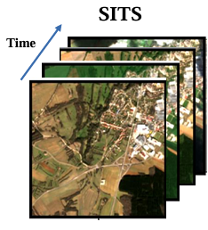
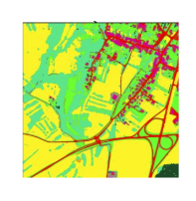
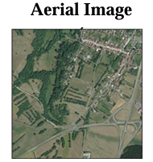
Baseline architecture (Supervised learning)
GSD: 10m
Temporal VIT
40
512
40
512
U-Net
Pixel-wise predictions
Encoder
Decoder
512
512
GSD: 0.2m

Slide 6
Self-Supervised Learning (SSL)
​
​
Self-supervised pre-training
2. Supervised fine-tuning
Segmentation Head
Projection Head
UNLABELED Dataset
Backbone
LABELED Dataset

Slide 7
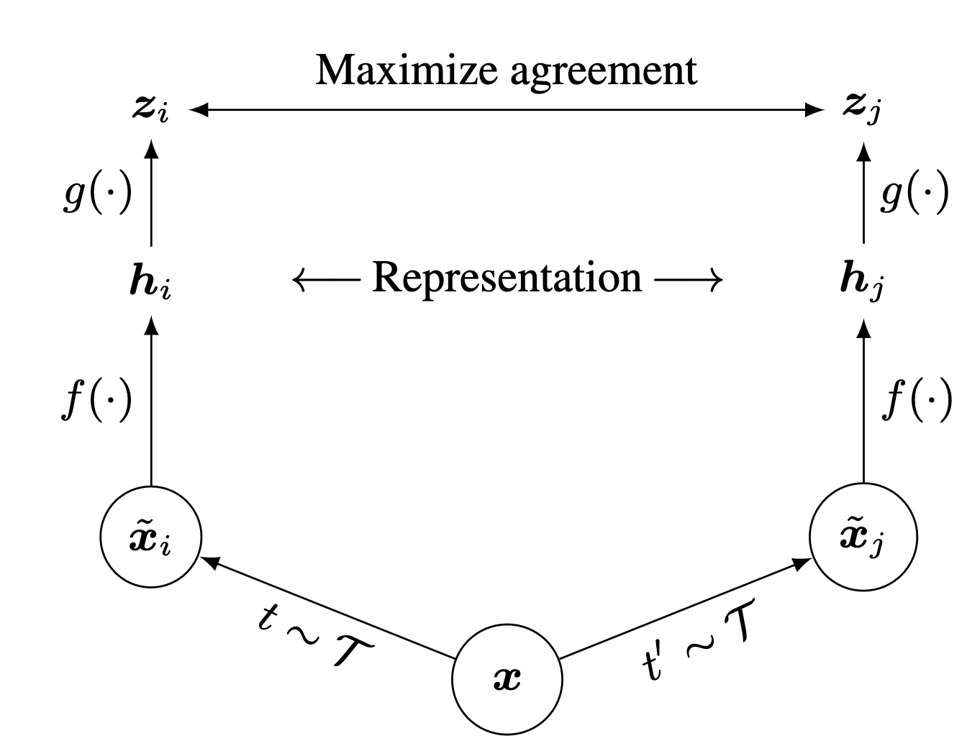
Contrastive Learning
A Simple Framework for Contrastive Learning of Visual Representations (SimCLR)
Transformation: t , t`
Views: x_{i} , x_{j}
Encoder: f ( . )
Feature map: h_{i} , h_{j}
MLP(Projection): g( . )
Feature Map(MLP): z_{i} , z_{j}

Slide 8
Projection Head (g)
f ( . )
2048
128
Temporal ViT
H_{i}
X_{i}
t
Z_{i}
Fully Connected
Fully Connected
ReLU
X_{i}
U-Net Encoder
SITS
f ( . )
Contrastive Learning
2048
128
Aerial
t`
Temporal ViT
H_{j}
X_{j}
Transformation : t , t`
Views: x_{i} , x_{j}
Encoder : f ( . )
Feature map : h_{i} , h_{j}
MLP(Projection) : g( . )
Feature Map(MLP): z_{i} , z_{j}
Fully Connected
Fully Connected
ReLU
Z_{j}
X_{j}
U-Net Encoder

Slide 9
Supervised fine-tuning
SITS
Temporal ViT
Segmentation Head
Aerial
U-Net Encoder
U-Net Decoder
Pixel-wise predictions

Slide 10
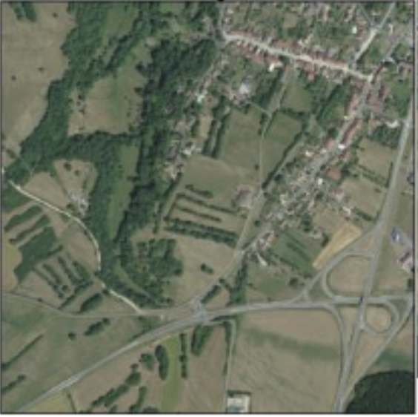
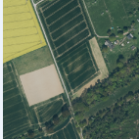
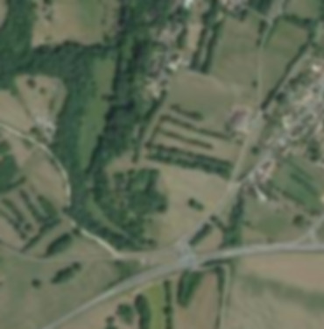
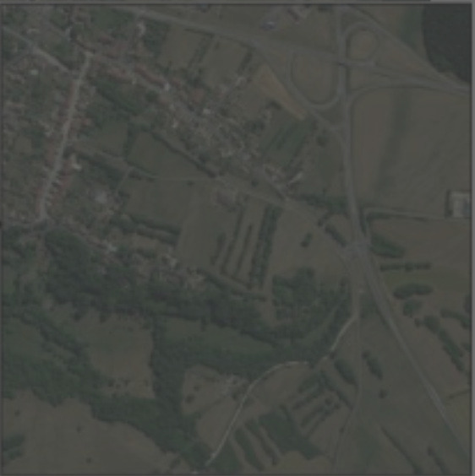

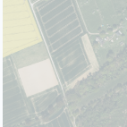
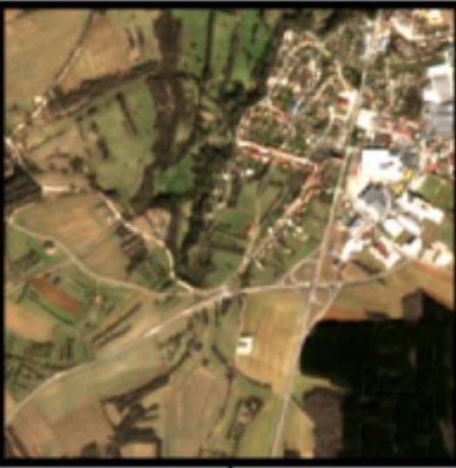
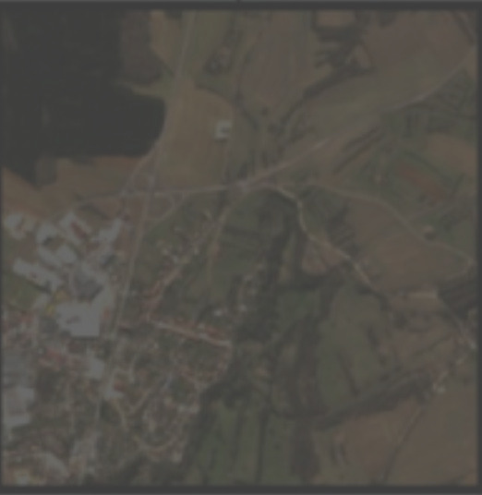
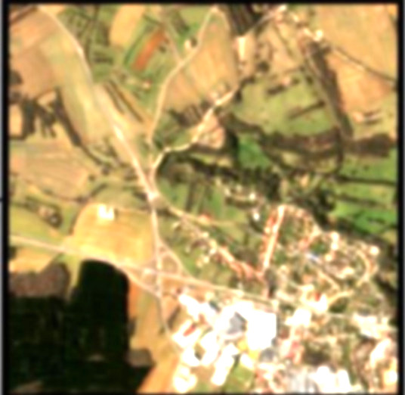
Positive and Negative pair generation
Data Augmentation
Geometric and Radiometric transformation
Cropping randomly and resizing (20%)
Gaussian blur
Erasing part of image
Brightness and contrast changes
Simulation of different lighting condition
Aerial
SITS

Slide 11
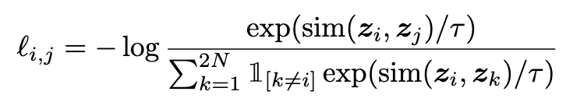
Contrastive learning loss
l _{i, j} : Loss for the image positive pair (i, j)
sim (z_{i} , z_{j} ) : Similarity measure between feature vectors z_{i​} and z_{j}​ (cosine similarity)
τ: Temperature parameter that scales the similarities
2N: Total number of images in the batch
1_{[k≠i]} : Indicator function that equals 1 if k≠i, and 0 otherwise
exp(⋅) : Exponential function

Slide 12
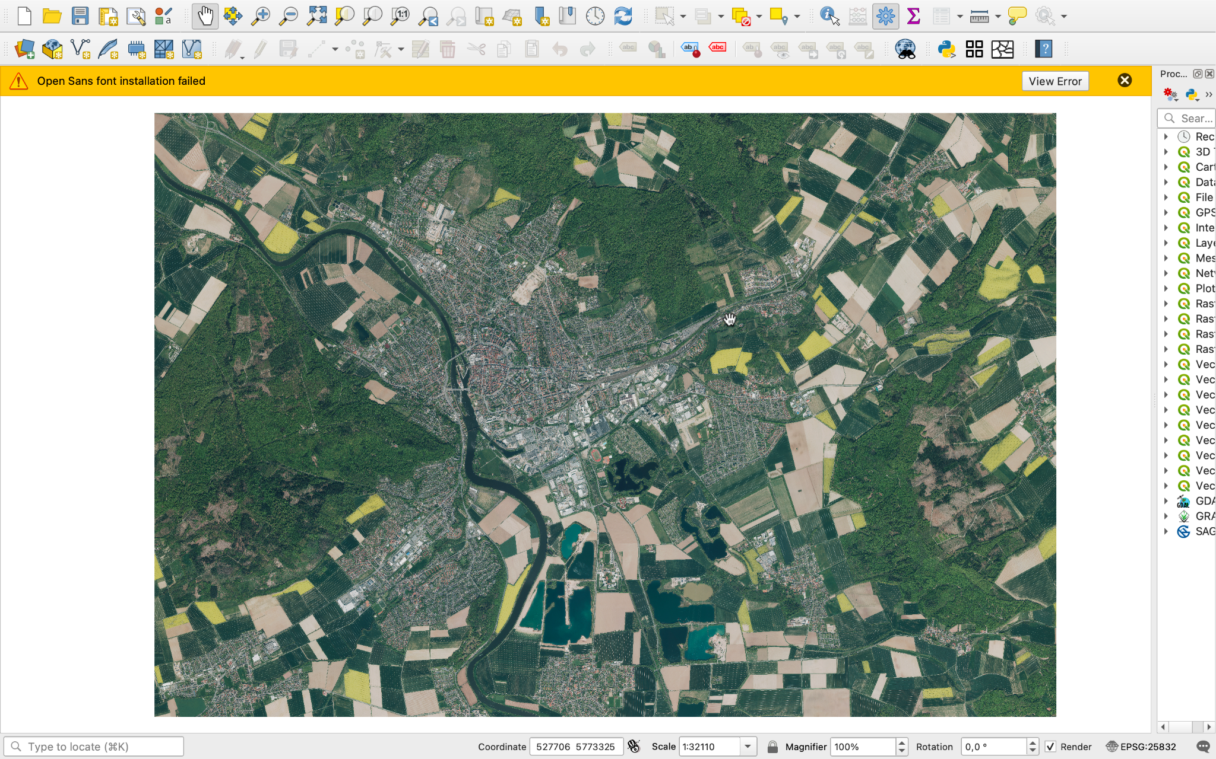
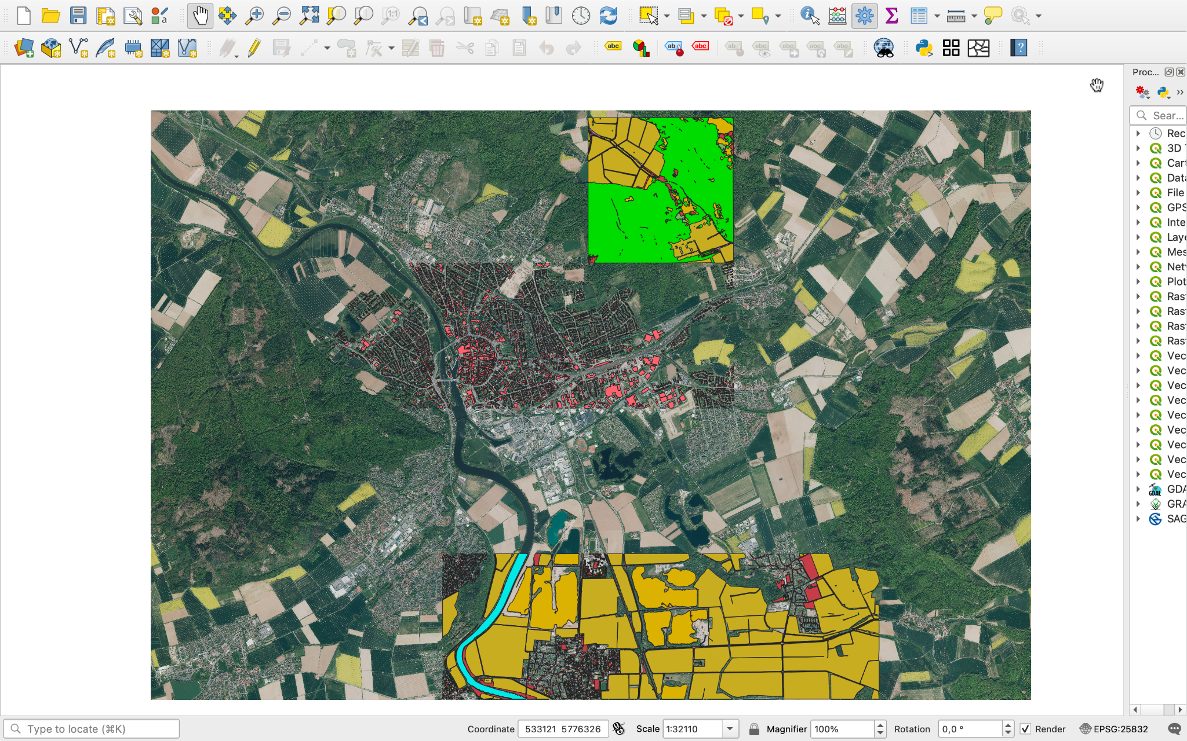
Data
Hameln:
Pre-training
Fine-Tuning
9322 Patches
2077 Patches

Slide 13
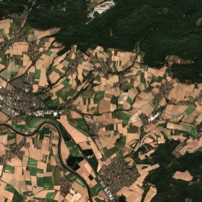
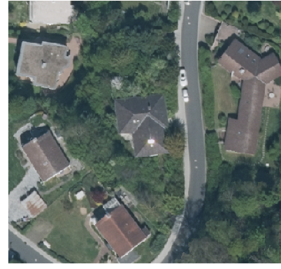
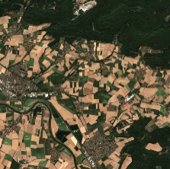
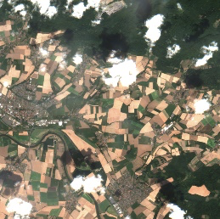
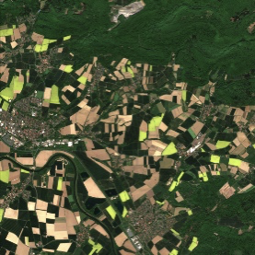
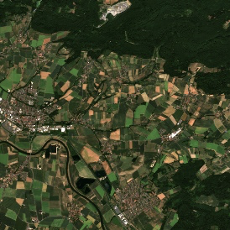
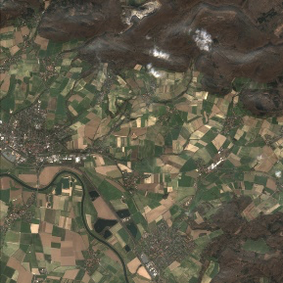
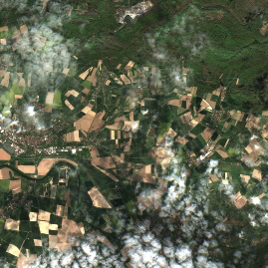
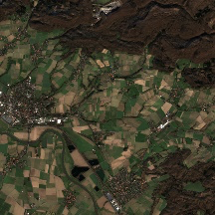
Data
Hameln:
SITS
Feb - Nov
GSD: 10 m
Channels: 10
Patch size: 40*40 pixels
length of time series:8
Aerial
Mono-Temporal
GSD: 0.2 m
Channels: 4(R,G,B,IR)
Patch size: 512*512 pixels
Time series
Aerial patch

Slide 14
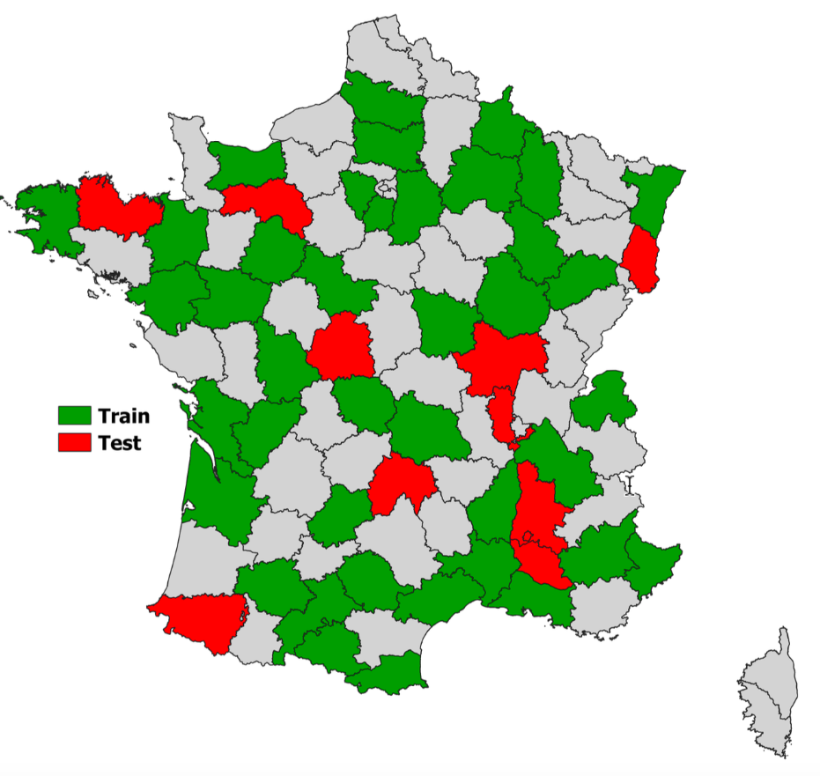
Data
FLAIR #2
Open-source dataset (France)
Task: LC classification
Contains aerial and SITS images
Labelled dataset
50 areas in France

Slide 15
Experiments
SSL
Supervised Learning
# | Pre-Training Data | Pre-Training Epochs | Fine-tuning Data | Fine-tuning Epochs | Batch | Temp
1 | Baseline (FLAIR 2) | 30 | Baseline | 5 | 16 | 0.1
2 | Hameln | 40 | Hameln | 20 | 16 | 0.1
3 | Hameln | 40 | Hameln | 20 | 8 | 0.7
# | Dataset | Epochs
1 | Baseline | 30
2 | Hameln | 50

Slide 16
Setup
Optimiser: Stochastic gradient descent with learning rate of 0.001
Supervised fine-tuning : Cross entropy loss with adjusted weights for imbalance class handling.
Batch size: 8, 16
Projection head: 2-layers FCN, ReLU activation
Temperature parameter : 0.7, 0.1
Evaluation metrics: IoU

Slide 17
Results
Hameln
# | Buildings | Underground working | Loose material | grass | reed | crop | Deciduous trees | Coniferous trees | grove | shrubbery | Running water | Standing water
SSL1 | 63.00 | 38.07 | 0.00 | 10.58 | 19.20 | 30.00 | 33.04 | 3.01 | 0.00 | 0.00 | 0.00 | 0.00
SSL2 | 73.00 | 39.00 | 0.00 | 15.00 | 25.6 | 37.22 | 35.80 | 6.80 | 0.00 | 0.00 | 0.00 | 0.00
SUP | 72.00 | 40.00 | 0.00 | 13.53 | 20.4 | 43.50 | 35.80 | 9.50 | 0.00 | 0.00 | 0.00 | 0.00
Baseline
# | Buildings | Pervious surface | Impervious surface | Bare soil | water | coniferous | deciduous | brushwood | vineyard | herbaceous vegetation | land | plowed land
SSL | 53.00 | 32.00 | 52.00 | 21.00 | 65.00 | 34.00 | 60.00 | 17.00 | 40.00 | 36.00 | 43.0 | 32.0
SUP | 77.80 | 45.90 | 68.00 | 33.80 | 82.20 | 29.50 | 64.7 | 21.4 | 56.1 | 41.00 | 49.2 | 37.60

Slide 18
Results
Dataset and method | mIoU | OA
Baseline SL | 50.63 | 66.80
Hameln SL | 19.56 | 47.74
Baseline SSL | 40.91 | 61.09
Hameln SSL | 16.41 | 38.42
Hameln SSL | 19.37 | 41.45

Slide 19
Limitations
Very few labeled images (2077) available.
Manual quality check of produced annotations.
Problem with batch size
Our batch size : 8
Reference paper minimum batch size 256

Slide 20
Conclusion
Implemented multimodal SSL on existing baseline.
Utilized the unlabelled data for model pre-training.
Supervised learning has better mIoU and OA than SSL in our experiments.
There is room for improvements.

Slide 21
Outlook
Getting more training data with labels.
Using method that does not rely on negative samples or require few negative samples.
Fusion module can be improved (Attention based)
Squeeze-Excitation
Residual-Excite

Slide 22
References
Garioud, Anatol, Apolline De Wit, Marc Poupée, Marion Valette, Sébastien Giordano, and Boris Wattrelos. "FLAIR: French Land cover from Aerospace ImageRy." arXiv, 2023. https://arxiv.org/abs/2305.14467.
Ting Chen, Simon Kornblith etc, A Simple Framework for Contrastive Learning of Visual Representations https://arxiv.org/abs/2002.05709
Linus Scheibenreif Jo¨elle Hanna Etc, Self-supervised Vision Transformers for Land-cover Segmentation and Classification https://ieeexplore.ieee.org/document/9857009
Yongshuo Zong, Oisin Mac Aodha Etc, Self-Supervised Multimodal Learning: A Survey https://arxiv.org/pdf/2304.01008

